Slide 1
IMS Project presentation
AYUB YUSUF
SDET programme (Software development engineer in test)

Slide 2
Project Objective
IMS project:
Build an application which interacts with a managed database
The application must use supporting tools, methodologies and technologies that encapsulates all modules covered during training

Slide 3
Technologies used
• Version Control System: Git
• Source Code Management: GitHub
• Kanban Board: Jira
• Database Management System: MySQL
• Back-End Programming Language: Java
• Build Tool: Maven
• Unit Testing: JUnit

Slide 4
Scope
• Code fully integrated into a Version Control System using the feature-branch model: master/dev/multiple features.
• A project management board with full expansion on user stories, acceptance criteria and tasks needed to complete the project.
• A risk assessment which outlines the issues and risks faced during the project timeframe.
• A relational database used to persist data for the project, containing the customers, products, orders, and orders_items tables. Relationships should be modelled using an ERD.
• A functional application ‘back-end’, following best practices and design principles, in the language that you have covered during training, meeting the requirements set on your project management board.
• A build of your application, including any dependencies it might need, produced using an integrated build tool.
• Unit tests for validation of the application. You should aim to reach the industry standard of 80% test coverage.

Slide 5
Scope
• Code fully integrated into a Version Control System using the feature-branch model: master/dev/multiple features.
• A project management board with full expansion on user stories, acceptance criteria and tasks needed to complete the project.
• A risk assessment which outlines the issues and risks faced during the project timeframe.
• A relational database used to persist data for the project, containing the customers, products, orders, and orders_items tables. Relationships should be modelled using an ERD.
• A functional application ‘back-end’, following best practices and design principles, in the language that you have covered during training, meeting the requirements set on your project management board.
• A build of your application, including any dependencies it might need, produced using an integrated build tool.
• Unit tests for validation of the application. You should aim to reach the industry standard of 80% test coverage.

Slide 6
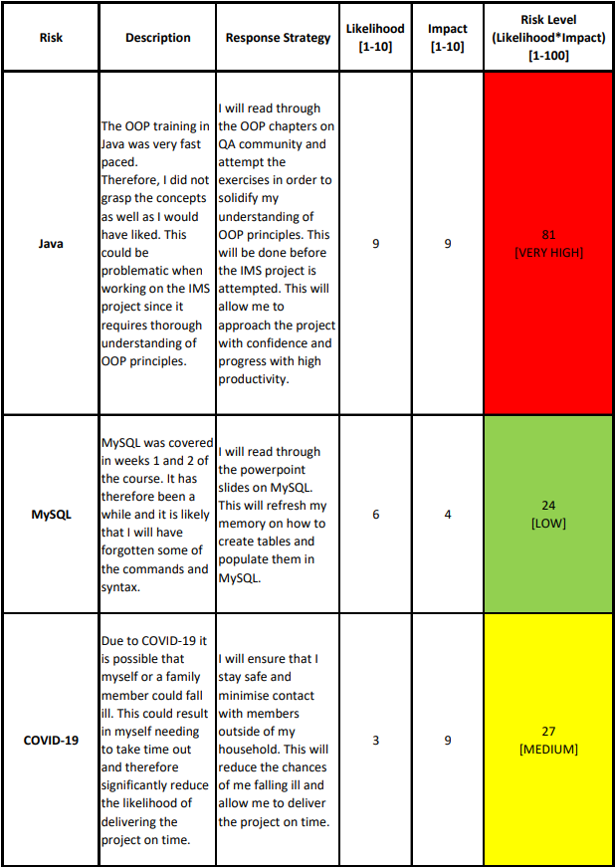
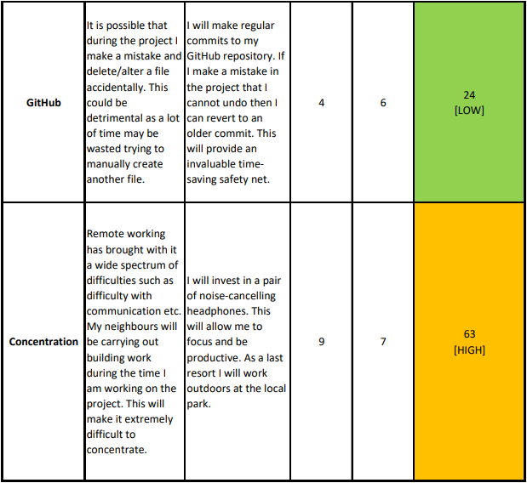
Risk Assessment

Slide 7
Scope
• Code fully integrated into a Version Control System using the feature-branch model: master/dev/multiple features.
• A project management board with full expansion on user stories, acceptance criteria and tasks needed to complete the project.
• A risk assessment which outlines the issues and risks faced during the project timeframe.
• A relational database used to persist data for the project, containing the customers, products, orders, and orders_items tables. Relationships should be modelled using an ERD.
• A functional application ‘back-end’, following best practices and design principles, in the language that you have covered during training, meeting the requirements set on your project management board.
• A build of your application, including any dependencies it might need, produced using an integrated build tool.
• Unit tests for validation of the application. You should aim to reach the industry standard of 80% test coverage.

Slide 8
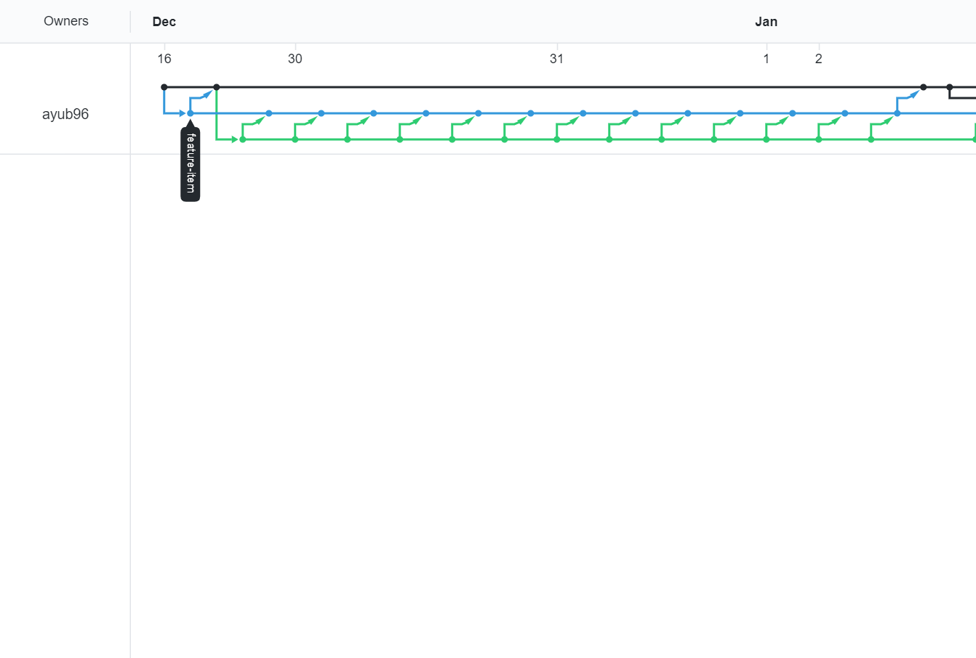
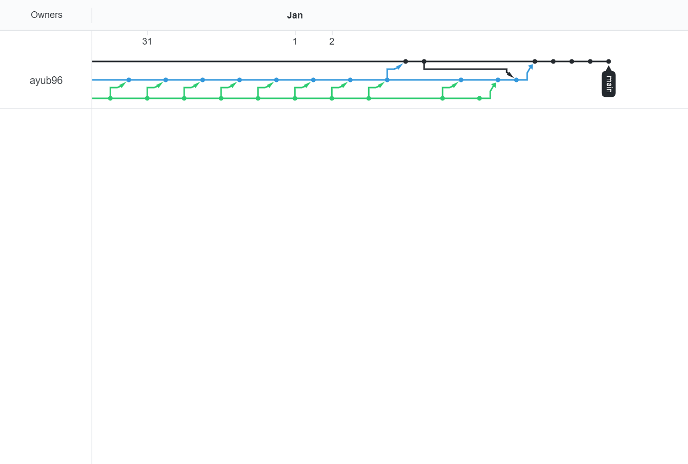
Version control system: Git

Slide 9
Scope
• Code fully integrated into a Version Control System using the feature-branch model: master/dev/multiple features.
• A project management board with full expansion on user stories, acceptance criteria and tasks needed to complete the project.
• A risk assessment which outlines the issues and risks faced during the project timeframe.
• A relational database used to persist data for the project, containing the customers, products, orders, and orders_items tables. Relationships should be modelled using an ERD.
• A functional application ‘back-end’, following best practices and design principles, in the language that you have covered during training, meeting the requirements set on your project management board.
• A build of your application, including any dependencies it might need, produced using an integrated build tool.
• Unit tests for validation of the application. You should aim to reach the industry standard of 80% test coverage.

Slide 10
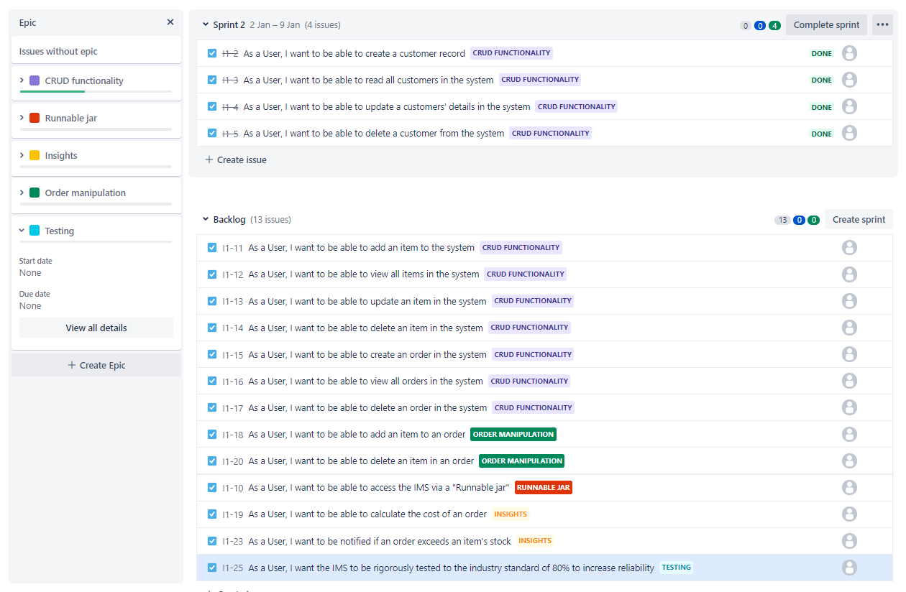
Project management board: Kanban
To effectively manage my project, I adopted an Agile approach.
I used a Kanban board (a feature of Jira) to manage my project.
The first step of the planning was to add to the backlog.

Slide 11
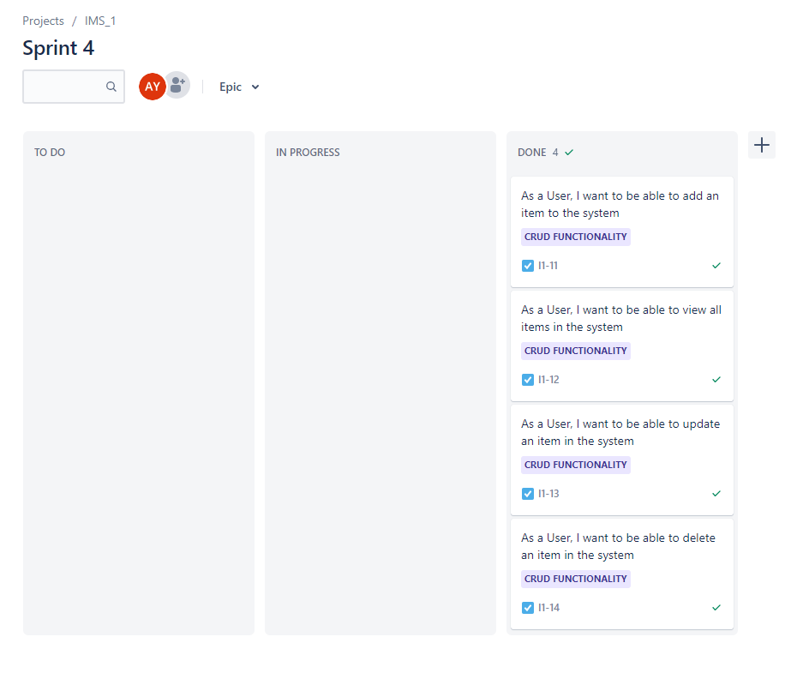
Project management board: Kanban
At the start of the day I would create a sprint and work on it throughout the day until marking it as done.

Slide 12
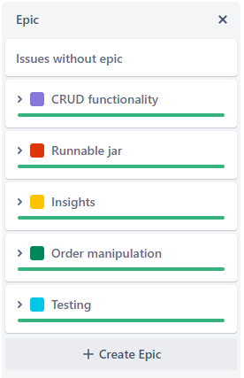
Project management board: Kanban
The following epics were created:
CRUD functionality
Runnable jar
Insights
Order manipulation
Testing
All epics were successfully completed.

Slide 13
Sprint review
The CRUD functionality epic for customers/orders/items was completed successfully
I wanted to add an extra ”date_placed” feature to the orders but this sprint got left behind because it was difficult to test

Slide 14
Sprint retrospective
Utililse .ignore file more often and use ”git add x” instead of “git add .”
This makes it clear which files have been changed after a commit.
I made the mistake of using “git add .” frequently and spotted the mistake later on in the project.

Slide 15
Scope
• Code fully integrated into a Version Control System using the feature-branch model: master/dev/multiple features.
• A project management board with full expansion on user stories, acceptance criteria and tasks needed to complete the project.
• A risk assessment which outlines the issues and risks faced during the project timeframe.
• A relational database used to persist data for the project, containing the customers, products, orders, and orders_items tables. Relationships should be modelled using an ERD.
• A functional application ‘back-end’, following best practices and design principles, in the language that you have covered during training, meeting the requirements set on your project management board.
• A build of your application, including any dependencies it might need, produced using an integrated build tool.
• Unit tests for validation of the application. You should aim to reach the industry standard of 80% test coverage.

Slide 16
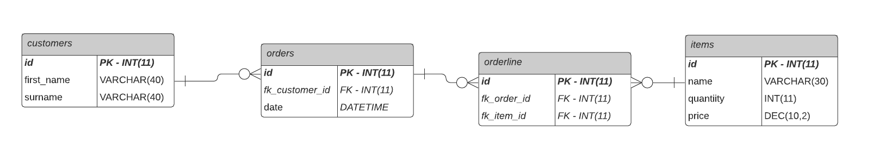
Relational database: ERD model

Slide 17
Scope
• Code fully integrated into a Version Control System using the feature-branch model: master/dev/multiple features.
• A project management board with full expansion on user stories, acceptance criteria and tasks needed to complete the project.
• A risk assessment which outlines the issues and risks faced during the project timeframe.
• A relational database used to persist data for the project, containing the customers, products, orders, and orders_items tables. Relationships should be modelled using an ERD.
• A functional application ‘back-end’, following best practices and design principles, in the language that you have covered during training, meeting the requirements set on your project management board.
• A build of your application, including any dependencies it might need, produced using an integrated build tool.
• Unit tests for validation of the application. You should aim to reach the industry standard of 80% test coverage.

Slide 18
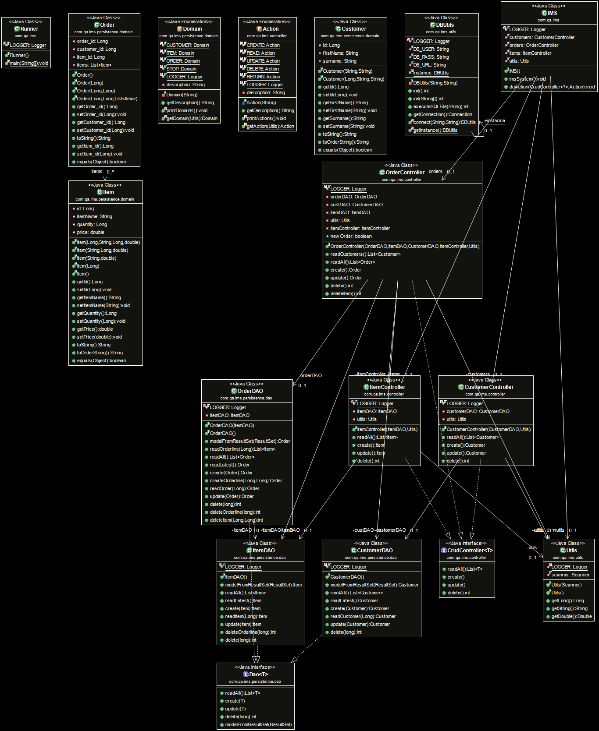
Back-end: UML diagram

Slide 19
Scope
• Code fully integrated into a Version Control System using the feature-branch model: master/dev/multiple features.
• A project management board with full expansion on user stories, acceptance criteria and tasks needed to complete the project.
• A risk assessment which outlines the issues and risks faced during the project timeframe.
• A relational database used to persist data for the project, containing the customers, products, orders, and orders_items tables. Relationships should be modelled using an ERD.
• A functional application ‘back-end’, following best practices and design principles, in the language that you have covered during training, meeting the requirements set on your project management board.
• A build of your application, including any dependencies it might need, produced using an integrated build tool.
• Unit tests for validation of the application. You should aim to reach the industry standard of 80% test coverage.

Slide 20
Build of application: fat .jar
I will now provide a demonstration of the application and its features.

Slide 21
Scope
• Code fully integrated into a Version Control System using the feature-branch model: master/dev/multiple features.
• A project management board with full expansion on user stories, acceptance criteria and tasks needed to complete the project.
• A risk assessment which outlines the issues and risks faced during the project timeframe.
• A relational database used to persist data for the project, containing the customers, products, orders, and orders_items tables. Relationships should be modelled using an ERD.
• A functional application ‘back-end’, following best practices and design principles, in the language that you have covered during training, meeting the requirements set on your project management board.
• A build of your application, including any dependencies it might need, produced using an integrated build tool.
• Unit tests for validation of the application. You should aim to reach the industry standard of 80% test coverage.

Slide 22
Testing
A coverage of 68.8% was achieved.
Due to this being my first project using Junit testing, I fell short of the industry standard of 80% coverage.

Slide 23
Test Demonstration
I will now demonstrate some of the tests I carried out.

Slide 24
Questions?

